Slide 1

Warehouse management
Paulina Golinska-Dawson, PhD eng.

Slide 2
Calculation of the storage modules
https://www.youtube.com/watch?v=w-xoT2riUV0

Slide 3
Standard europalet
Length: 1,200 mm (1.2 m)
Width: 800 mm (0.8 m)
Height: 144 mm (0.144 m)
Standard weight: approximately 25 kg
📦 Load capacity:
Dynamic load (when moved): up to 1,500 kg
Static load (when stationary): up to 4,000 kg

Slide 4
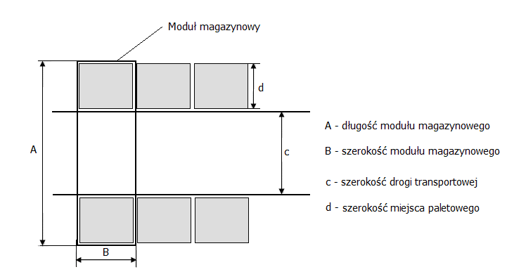
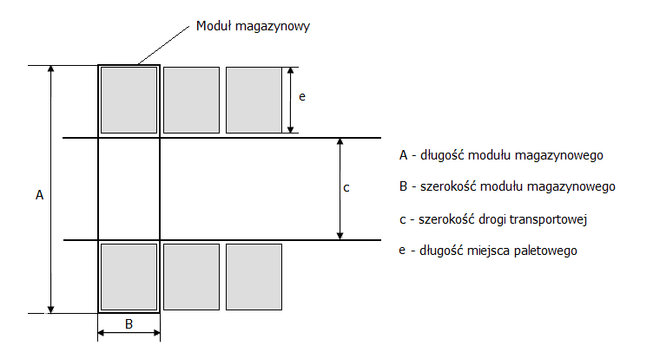
Warehouse module (cubic)
The warehousing module- the pallet place is arranged with the longer side parallel to the transport aisle
B– lenght pallet space
c – width of the transport aisle
d – width palet space
The warehousing module- the pallet place is arranged with the shorter side parallel to the transport aisle
B – width of pallet space
c – width of the transport aisle
e – lenght of pallet space

Slide 5
Calculation of the width of transportation aisle
a- width of a mean of transportation
C
C
C
C
C
C
C
C

Slide 6
Example
Width of the transportation aisle: 1200 mm (manual operations)
Width of the transportation aisle: 2400-3300 mm (forklift truck)
1200mm+10 0mm
Pallet
Aisle/
Internal road
Pallet
2x(Width of pallet 800mm+ 100 mm /pallet) + Width of transportation aisle

Slide 7
The surface of the module
M= (2d+c)* L
C – width of transportation aisle
d – width of pallet space
L – lenght of the pallet space
Surface of the storage space
P= M* (Zmax/2*w)
Where:
Zmax- maximum storage capacity (for homogeneous loading units)
w – number of stacking layers (for raking system it is the number of rack levels)

Slide 8
Example 2
Calculate the surface of 2 storage modules for row storage. Storage is carried out on industrial pallets (1000 mm x1200 mm), and the width of the transport route is 3.5 m. Pallets are arranged perpendicular to the transport routes
Dimension 1
Dimesion 2

Slide 9
Solution
M= ((2x (1,2+0,1m)+3,5m)) x 2x(1m +0,1 m) = 13,42 m2
M= (2d+c)* L

Slide 10
Example
Calculate the surface of modules shown in the previous Figure if storage is on Euro pallets and the width of the transport route is 2.5 m.

Slide 11
Solution
Surface of module
M= (2f+c)* L
C - width of transportation aisle
f – n_{rzi} *S_{g} (widgh of paller); n_{rzi} – number of loading units in the row (horizontal)
L – lenght of module= l * n_{rzj} ; gdzie l- lenght of pallet space; n_{rzj} - number of rows in the block (perpendicularly)
Surface of storage space
Ps= n*M
N- number of modules

Slide 12
Storing in blocks
Surface of module
M= (2f+c)* L
c - width of transportation aisle
f – n_{rz} x d (width of pallet space ); n_{rz} – number of blocks in row
L – lenght of block= l * n_{rzj} ; gdzie l- lenght of pallet; n_{rzj} – Number of pallets in block
Storage space (Ps)
Ps= (n x M)+ (n_{c} x c₎
n- number of modules
c – width of transportation road
n_{c} number of aisles

Slide 13
Task
calculate the module field for block storage, where the transport path width is 4.5 m, and each block holds 12 pallets (4x3). Storage is carried out on industrial pallets.

Slide 14
Solution
Surface of the module
M= (2f+c_{r})x L = (2x( 5,2m+ 4,5)) x3,3m = 57,72m
C – 4,5 m,
f – n_{rz} xd = (1,2m+0,1 m) x 4= 5,2m
L – lenght of block= l * n_{rzj} = (1m+ 0,1m)x3 = 3,3 m
Storage space (Ps)
Ps= n*M
n- number of modules

